Slide 1
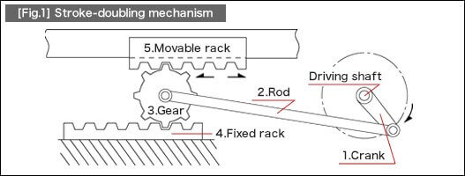
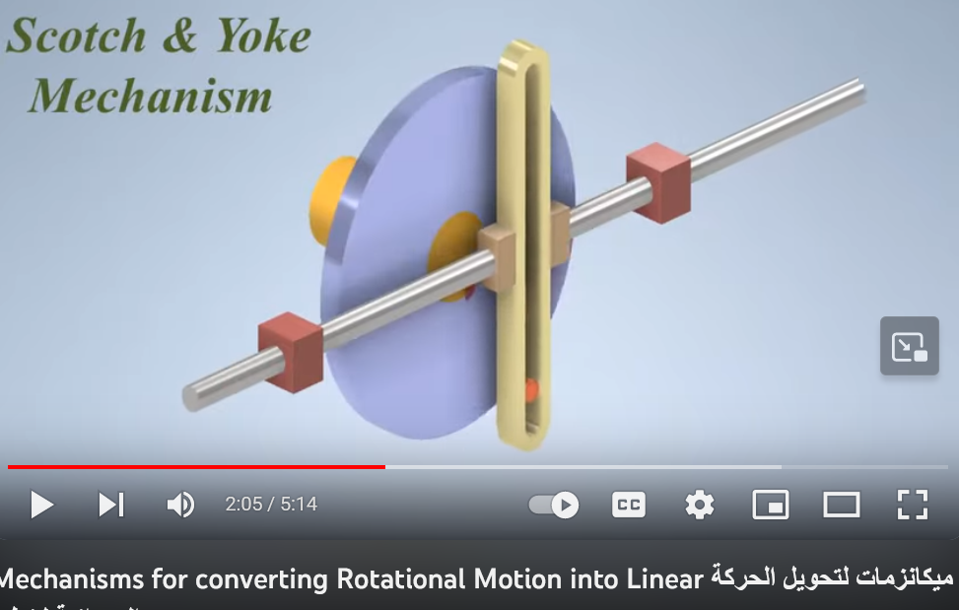
https://us.misumi-ec.com/blog/rotary-to-linear-motion/

